Slide 1
Digital Twin of Power Converter Systems Identification and Optimization for Reliability
Fernando Troya
Dr. Ing. Martin Votava
03-03-2025

Slide 2
Outline
Introduction & Motivation
Review of Identification Methods
Methodology
Results
Conclusion

Slide 3
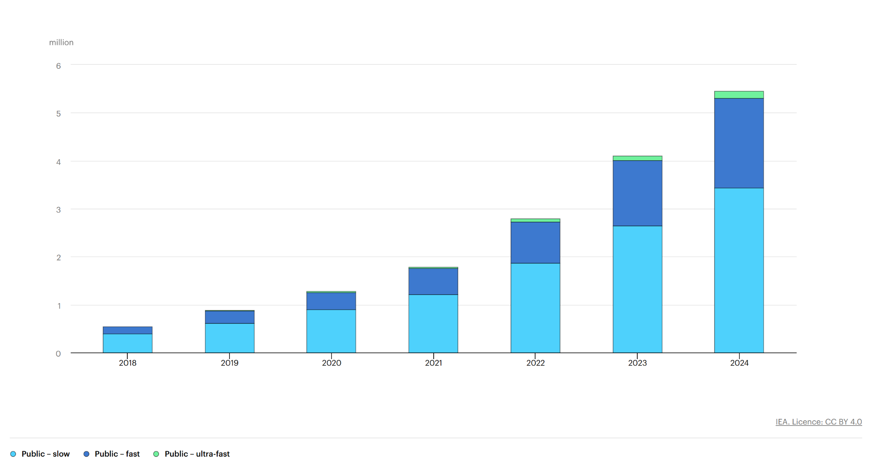
Motivation
EV charger Trends:
EV charger Trends
Increase in EV chargers
Higher power charger trend
Fast charging
Increased converter usage
Need for robust reliability and health monitoring.
Need for accurate thermal models to maximize safe converter usage.
Real time embedded deployment of monitoring
Fig.1 EV charger Trends [1]
Introduction
Review
Methodology
Results

Slide 4
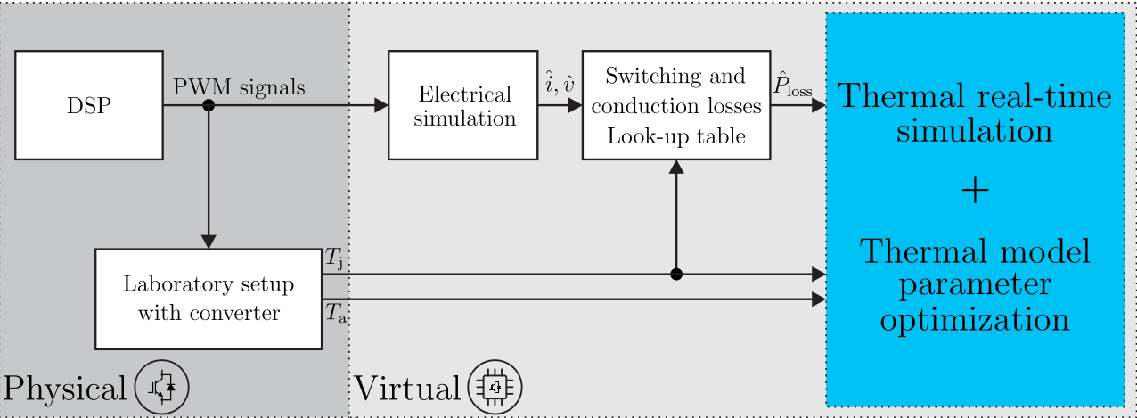

Introduction to Digital Twins
The DT processes real-time sensor data $(I,V,T)$to adapt a twin model of a process.
Thermal 'constants' drift due to aging; the Digital Twin adaptively mirrors the physical module's degradation.
Fig.2 Digital twin Topology [2]
Introduction
Review
Methodology
Results
Kuprat et al. Dynamic mode decomposition with control [2]
Notes:
Provide insight into non measurable variables

Slide 5
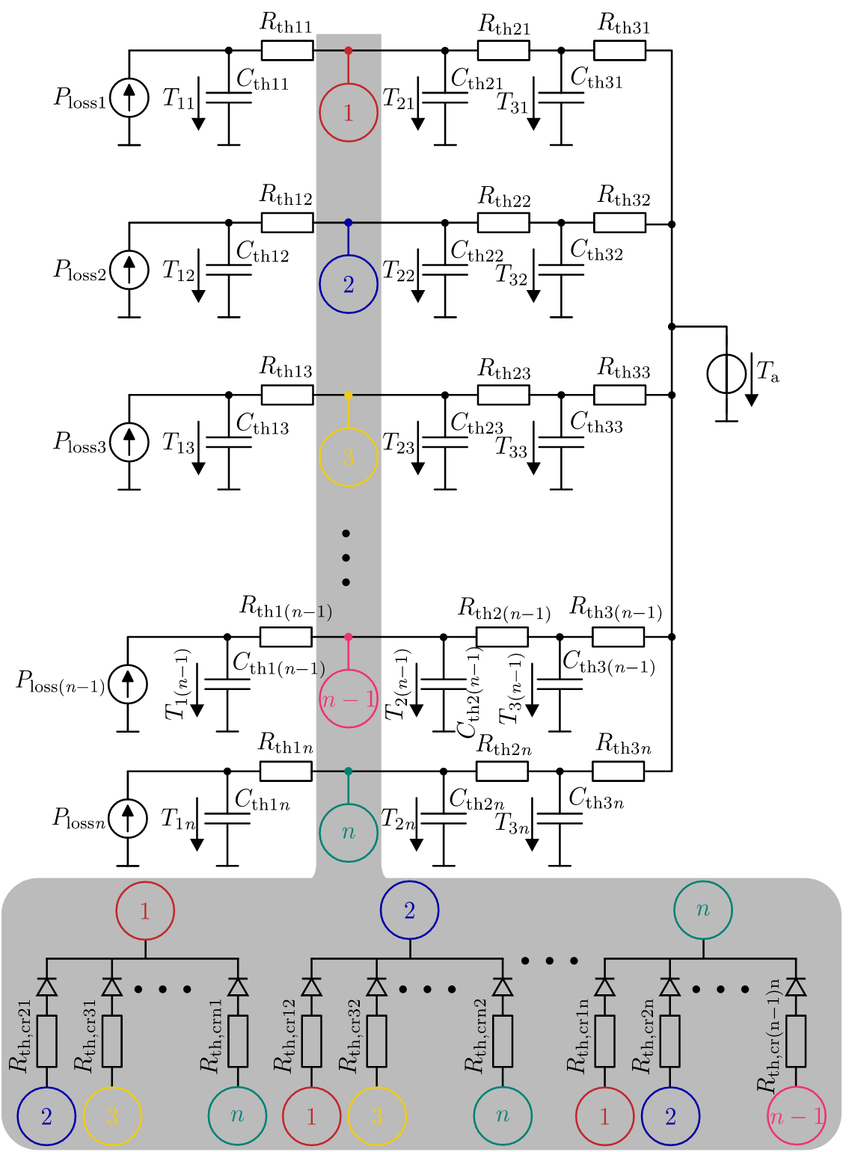
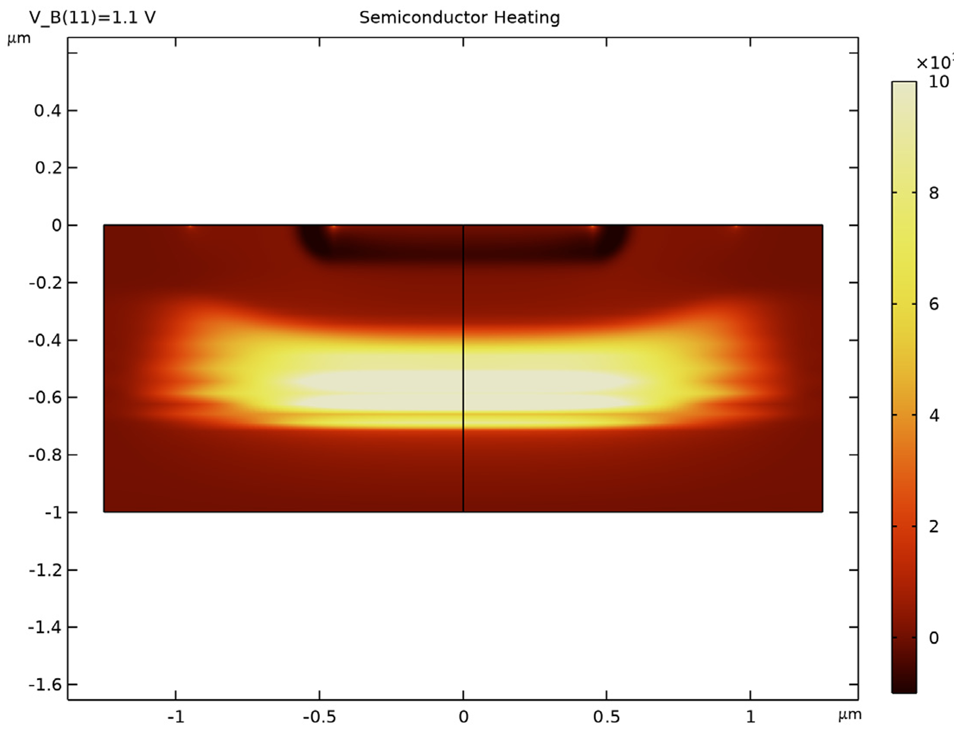
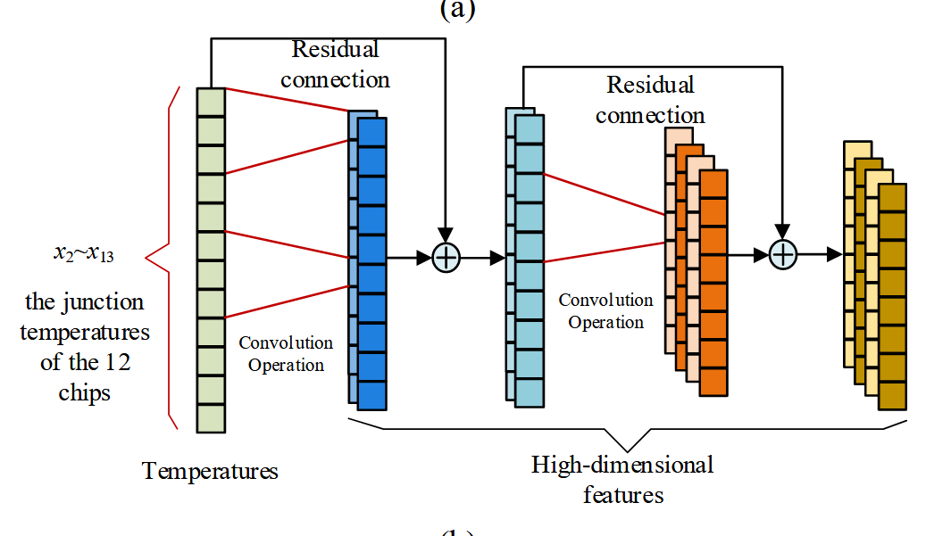
Models
Common modeling approaches include Lumped Parameter Thermal Networks (LPTN), FEA, and Data-Driven models.
Fig.5 Data driven modelling [4]
Fig.4 Semiconductor Heating FEA[3]
Fig.3 Cauer Network [2]
Introduction
Review
Methodology
Results
Notes:
Lump, represent thermal res and cap properties as elect RC
FEA simulates heat diffusion PDE
Data driven trains models with big datasets

Slide 6
Cauer network Parameter identification
Monitoring Principle
Network layers represent physical layers.
Node Temperatures represent average physical temperatures
Variation in thermal parameters correlated with physical degradation.
Advantages
Disadvantages
Easy Implementation in embedded systems
Computationally light
Easy interpretation
Over-simplifies dynamics
Parameters are not measurable
Thermal parameters are fixed
Fig.3 Cauer Network [2]
A reliable computationally light identification method is required
Introduction
Review
Methodology
Results
Kuprat et al. Dynamic mode decomposition with control [2]

Slide 7
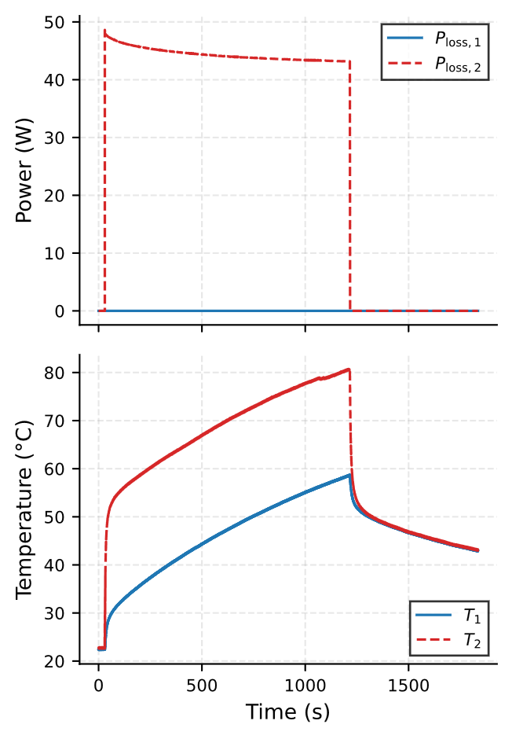
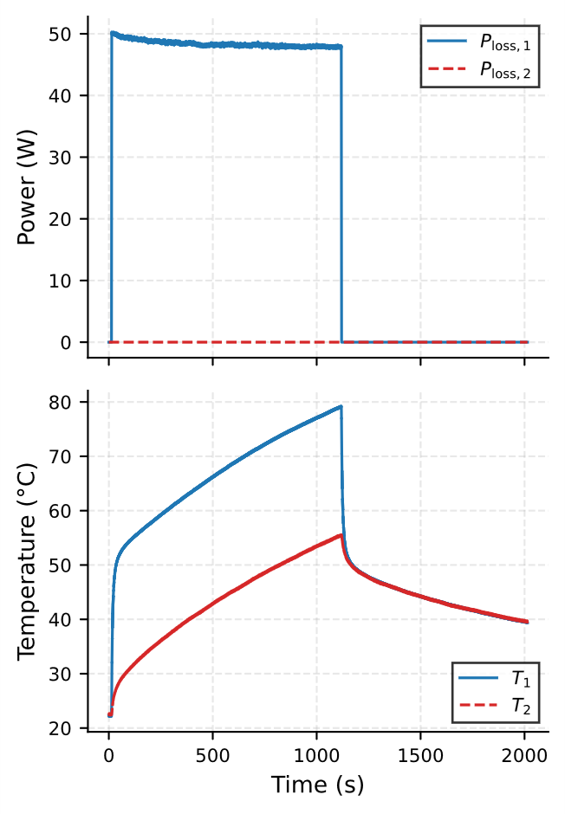
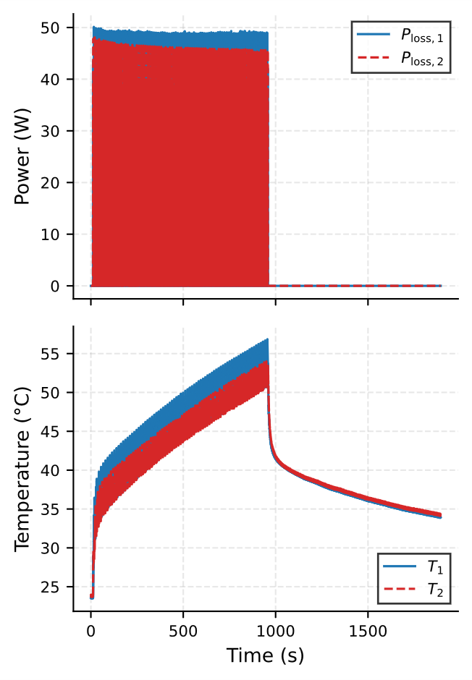
Experimental Validation
Experimental Validation Strategy: EKF, PSO and a data driven apporach will be analyze for feasability
(PSO & EKF): Validated on single-chip self-heating data to identify localized Cauer parameters.
Data-Driven (H-DMD): Validated on a dual-chip setup with cycling power to capture complex thermal cross-coupling.
.
P2
P1
T2
T1
Fig. 6 Experiment A self heat [†]
Fig. 7 Experiment B self heat [†]
Fig. 8 Experiment C cycling [†]
Introduction
Review
Methodology
Results

Slide 8
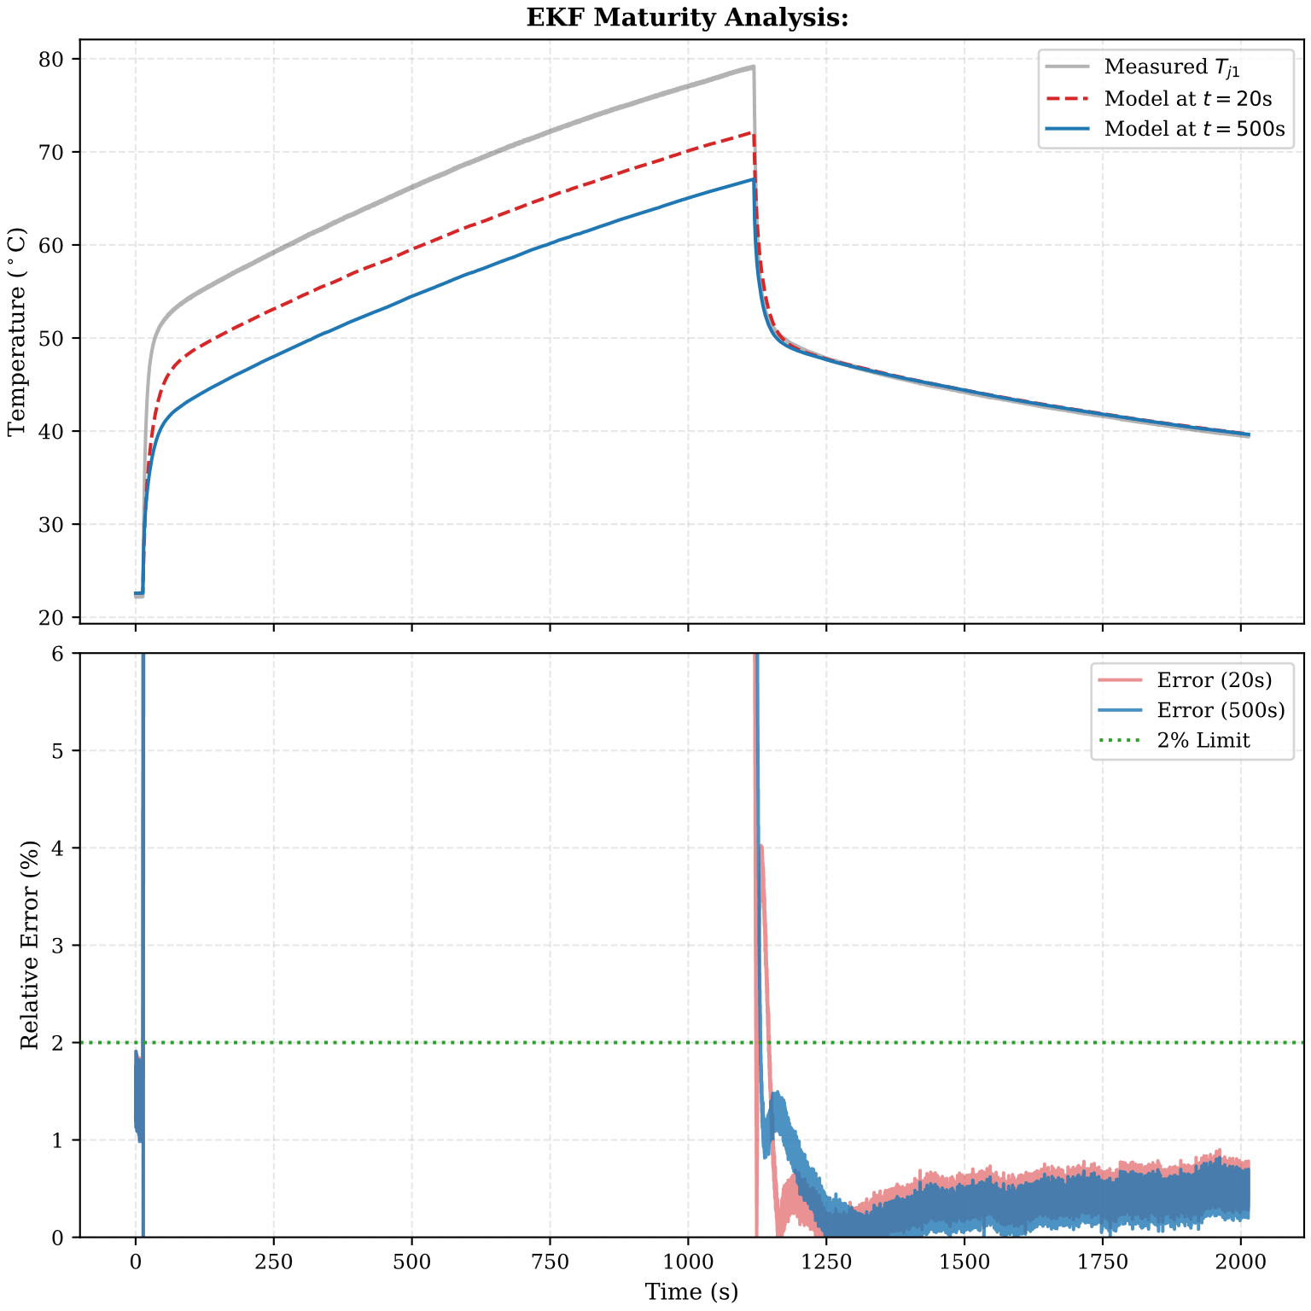
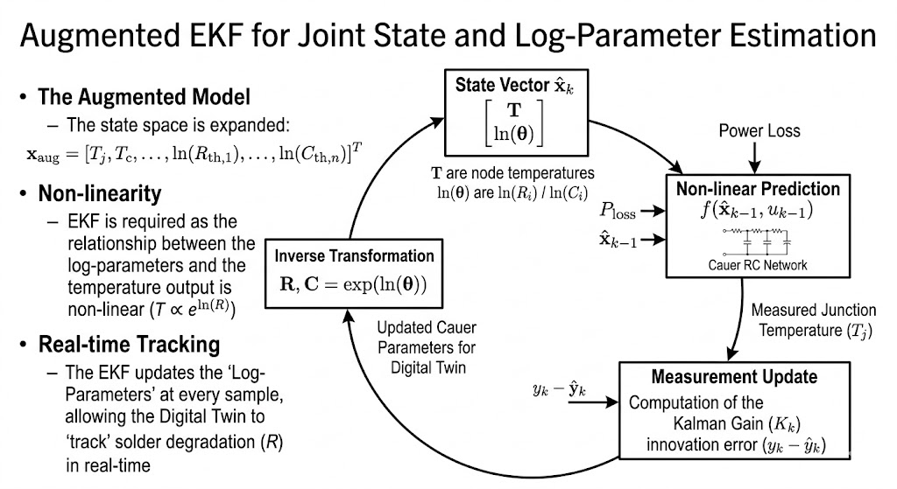
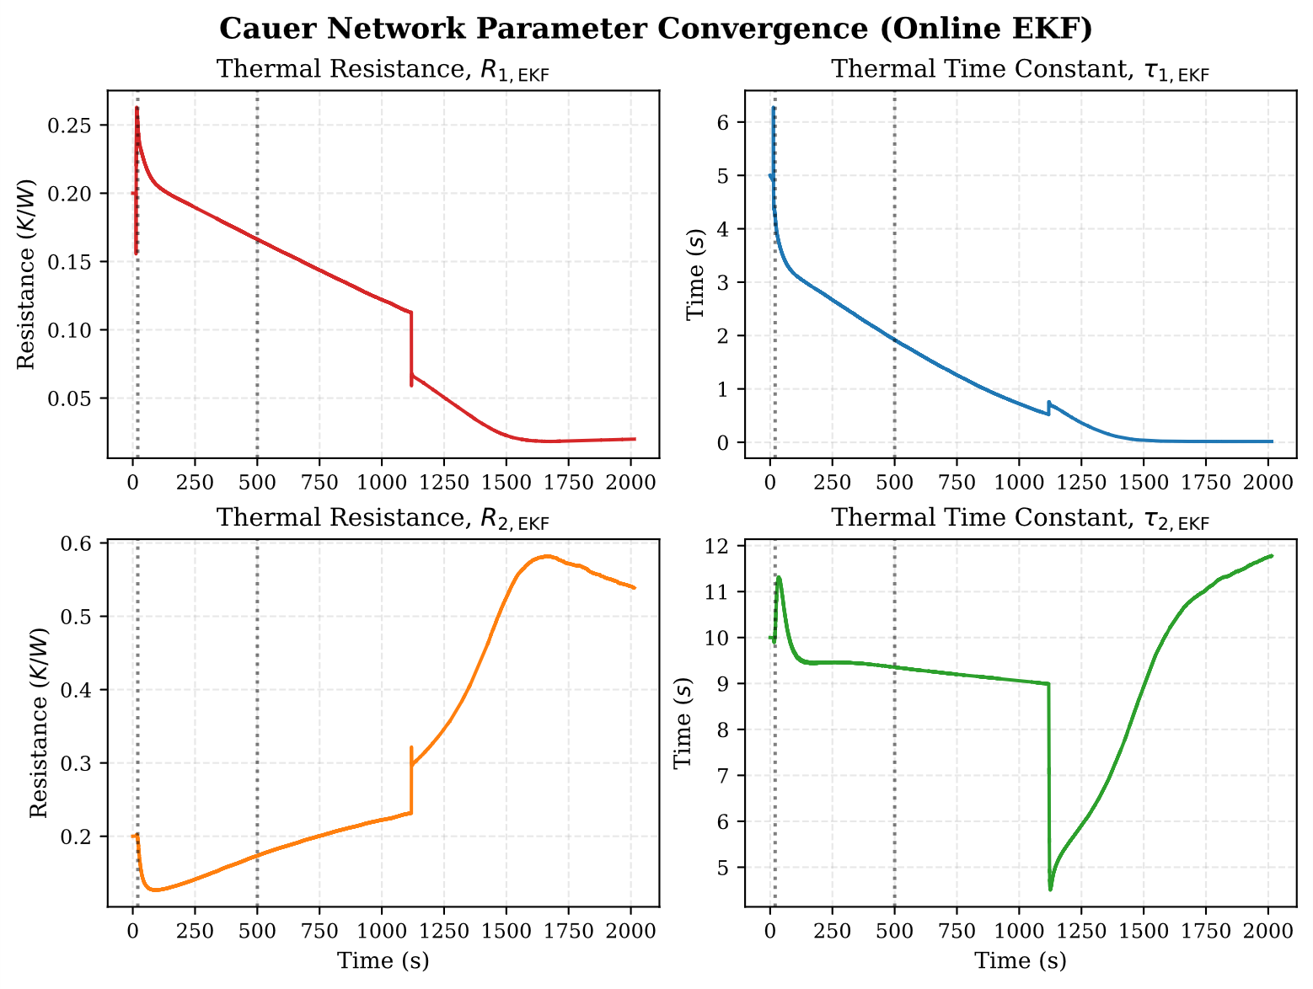
EKF
Initial guess
Initial guess
adapted model
adapted model
Fig. 9 EKF scheme
Fig. 10 EKF convergence
Fig. 11 EKF validation
Good for one step prediction
Can not separate the fast and slow dynamics
Introduction
Review
Methodology
Results

Slide 9
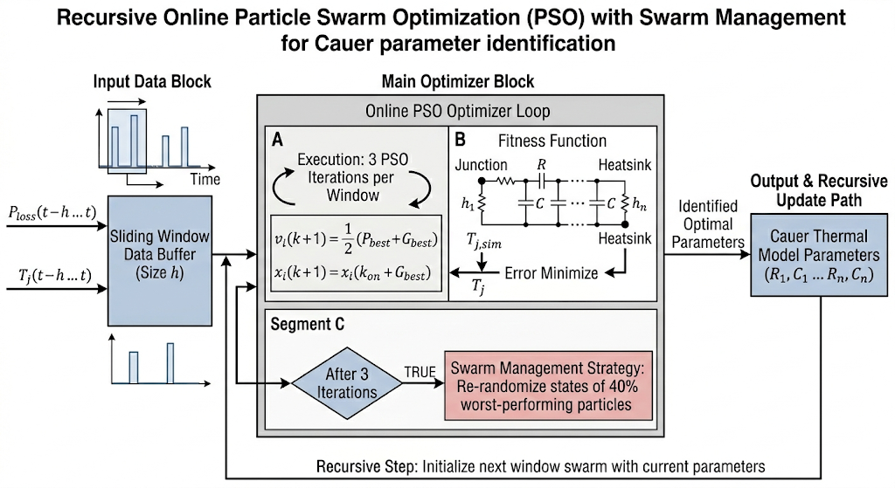
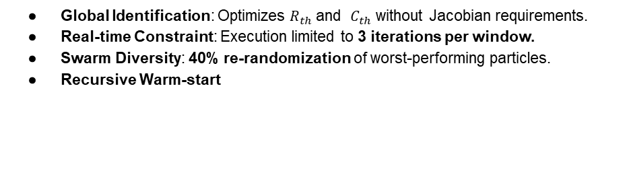
PSO
Global Identification: Optimizes $R_{th}$ and $C_{th}$ without Jacobian requirements.
Real-time Constraint: Execution limited to 3 iterations per window.
Swarm Diversity: 40% re-randomization of worst-performing particles.
Recursive Warm-start
Fig. 12 Online PSO [*]
Introduction
Review
Methodology
Results
Notes:
Is usually offline
Global stochastic
Local minima stuck
Simulation rankings

Slide 10
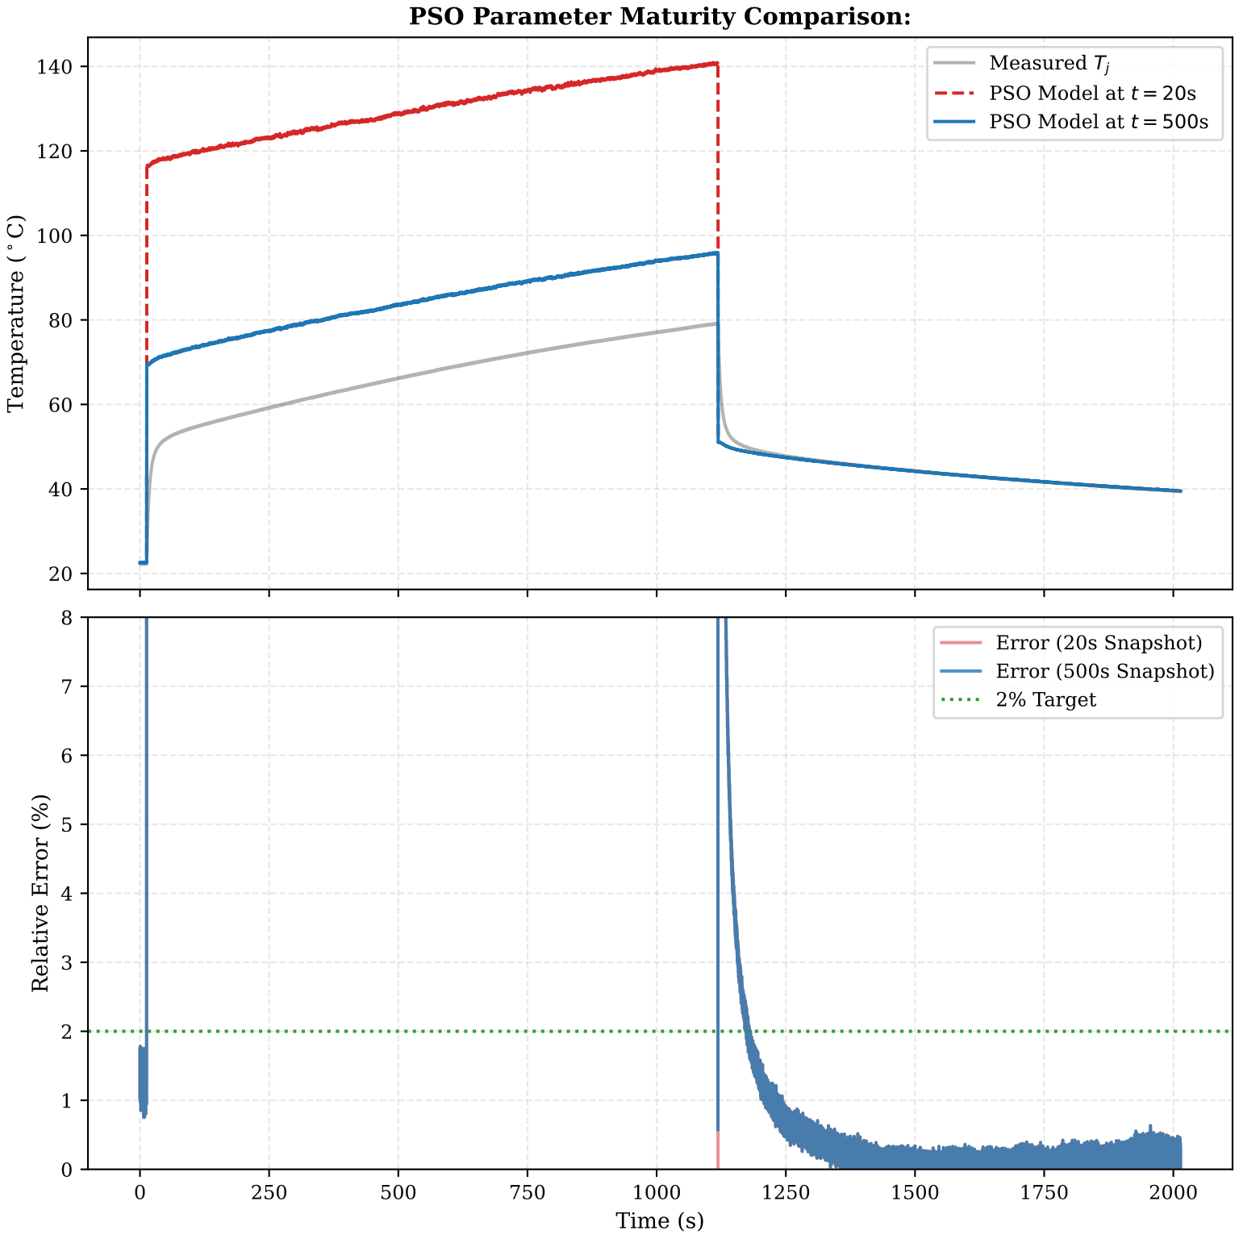
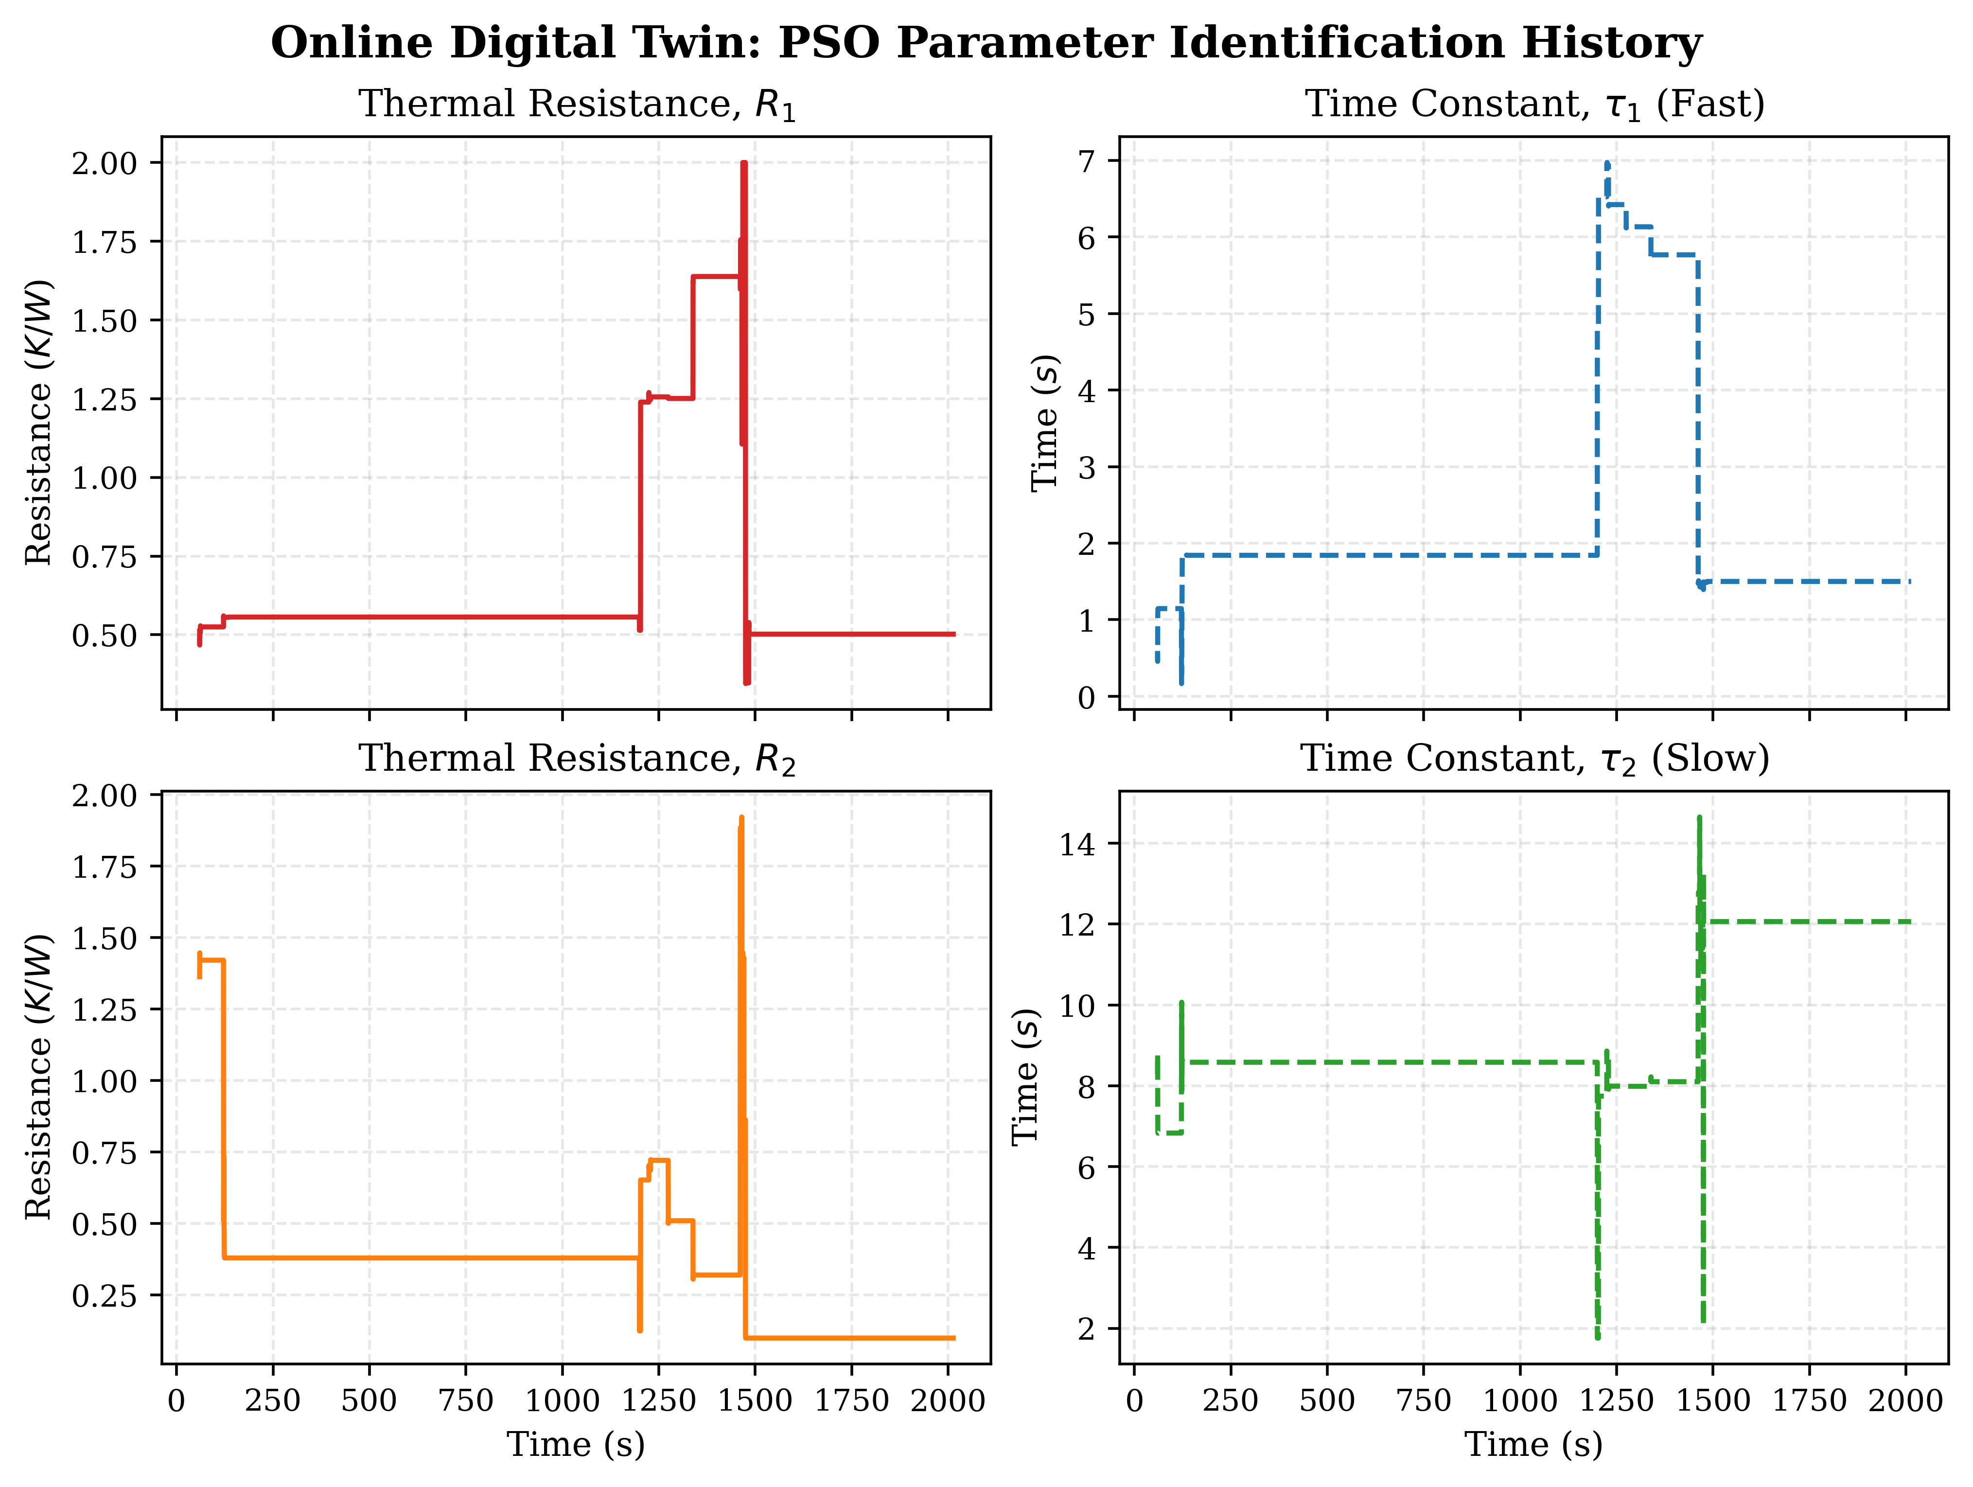

PSO accuracy
PSO Identification Accuracy
Validation: Tested on single-chip self-heating
Steady-State Precision: Achieves during stable operating points
Transient Dynamics:error "spikes" occur during high $\frac{dP}{dt}$ events
Convergence: Rapid parameter stabilization within the first 3–5 windows
Initial guess
Adapted model
Initial guess
Adapted model
Fig. 14 PSO Validation
Fig. 13 PSO Convergence
Introduction
Review
Methodology
Results

Slide 11
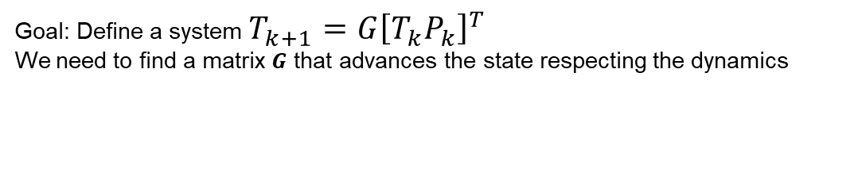
Data Driven DMD
Goal: Define a system $T_{k+1}=G{\left[T_{k}P_{k}\right]}^{T}$
We need to find a matrix $G$ that advances the state respecting the dynamics
Introduction
Review
Methodology
Results
Based: Proctor et al. Dynamic mode decomposition with control [5]
Notes:
We need to capture the slow and fast dynamics, we augment the state-> time embeddings
The blocks have repeating patterns in the heating dynamics and lags

Slide 12
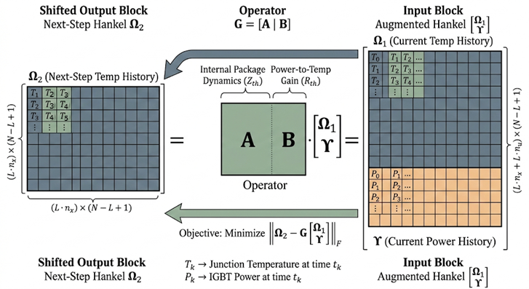
Data Driven DMD
Goal: Define a system $T_{k+1}=G{\left[T_{k}P_{k}\right]}^{T}$
We need to find a matrix $G$ that advances the state respecting the dynamics
Fig. 15 Hankel DMD [*]
Introduction
Review
Methodology
Results
Based: Proctor et al. Dynamic mode decomposition with control [5]
Notes:
We need to capture the slow and fast dynamics, we augment the state-> time embeddings
The blocks have repeating patterns in the heating dynamics and lags

Slide 13
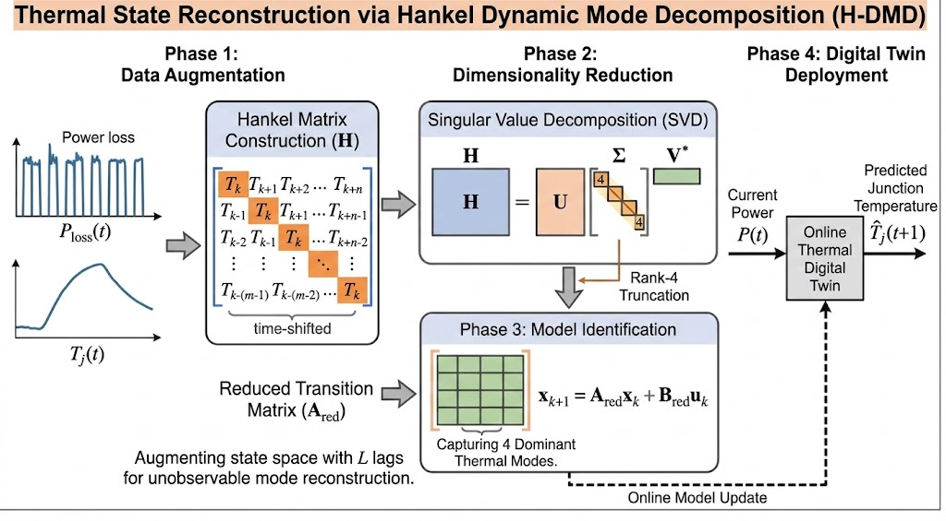


Data Driven DMD
Goal: Define a system $T_{k+1}=G{\left[T_{k}P_{k}\right]}^{T}$
Fig. 16 DMD DT Scheme [*]
Fig. 15 Hankel DMD [*]
$$G=Ω_{2}{ Ω}_{aug}^{−1}$$
Computationally expensive
Introduction
Review
Methodology
Results
Based: Proctor et al. Dynamic mode decomposition with control [5]
Notes:
We need to capture the slow and fast dynamics, we augment the state-> time embeddings
The blocks have repeating patterns in the heating dynamics and lags

Slide 14
Data Driven DMD
Goal: Define a system $T_{k+1}=G{\left[T_{k}P_{k}\right]}^{T}$
Repeating patterns
Fig. 16 DMD DT Scheme [*]
Fig. 15 Hankel DMD [*]
$$G=Ω_{2}{ Ω}_{aug}^{−1}$$
Computationally expensive
Introduction
Review
Methodology
Results
Based: Proctor et al. Dynamic mode decomposition with control [5]
Notes:
We need to capture the slow and fast dynamics, we augment the state-> time embeddings
The blocks have repeating patterns in the heating dynamics and lags

Slide 15
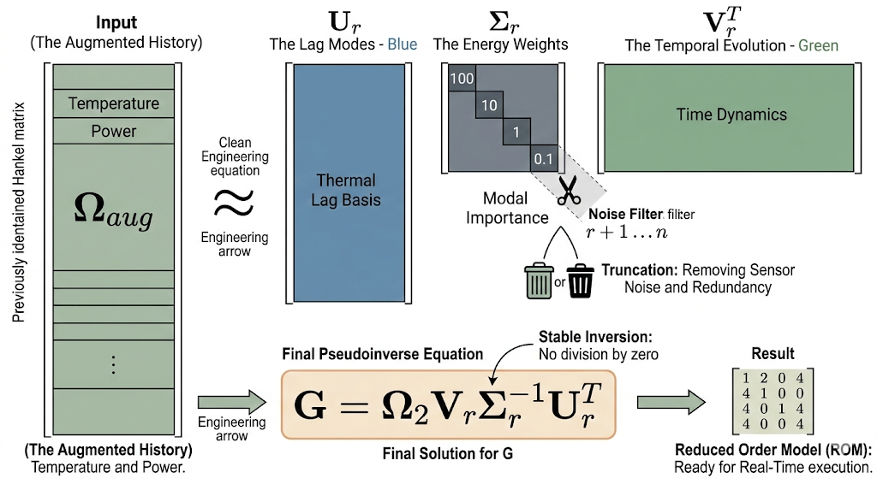
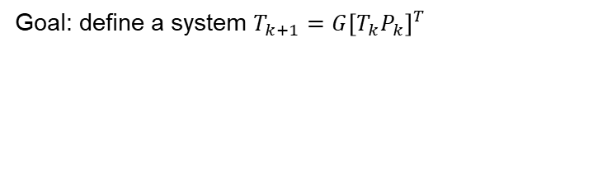

Data Driven DMD
Goal: define a system $T_{k+1}=G{\left[T_{k}P_{k}\right]}^{T}$
$$G=Ω_{2}{ Ω}_{aug}^{−1}$$
Computationally expensive
Fig. 16 DMD DT Scheme [*]
Fig.17 SVD psudo-inversion [*]
Introduction
Review
Methodology
Results
Based: Proctor et al. Dynamic mode decomposition with control [5]
Notes:
Break down omega aug into its principal components
Truncate the components with highest weight/energy
Aproximate omega
Invert omega

Slide 16
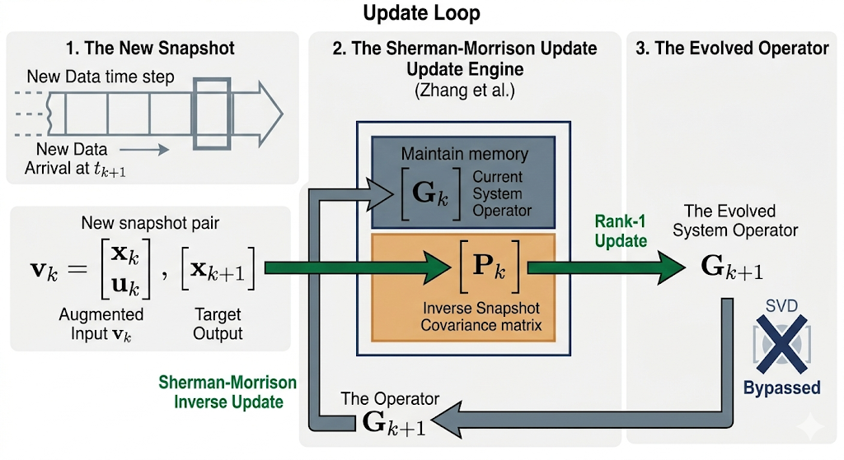
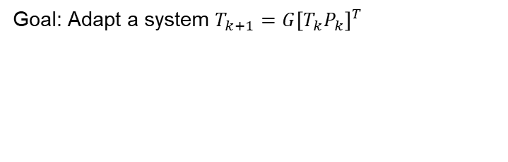
Data Driven DMD
Goal: Adapt a system $T_{k+1}=G{\left[T_{k}P_{k}\right]}^{T}$
Fig. 18 Online DMD RLS [*]
Fig. 16 DMD DT Scheme [*]
Introduction
Review
Methodology
Results
Based: Zhang et al. Online dynamic mode decomposition for time-varying systems[6]
Notes:
RLS for matrices
nstead of storing the whole history, we only store two compact matrices: the current operator and the inverse covariance P
Sherman-Morrison formula to update the inverse cov P, basically no need to update P and invert again, can directly update the inverse
($\rho$): Emphasize that $\rho$ (e.g., $0.9999$)

Slide 17
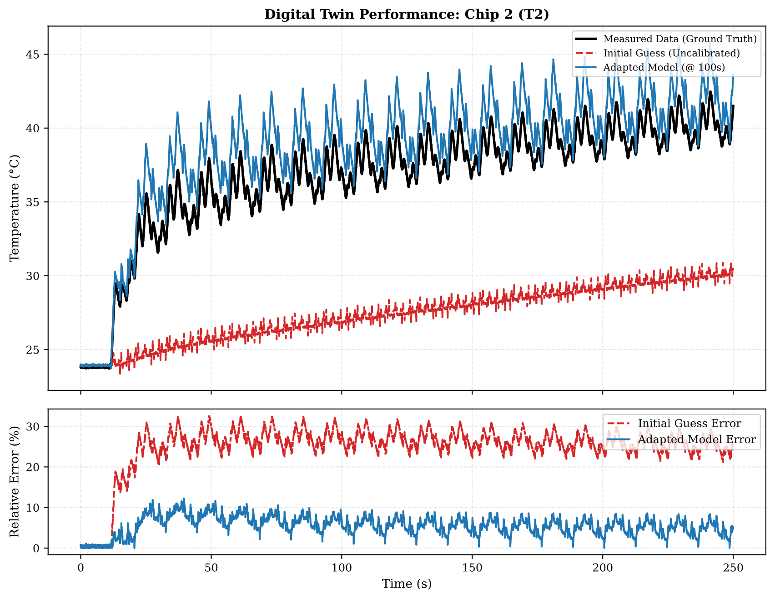
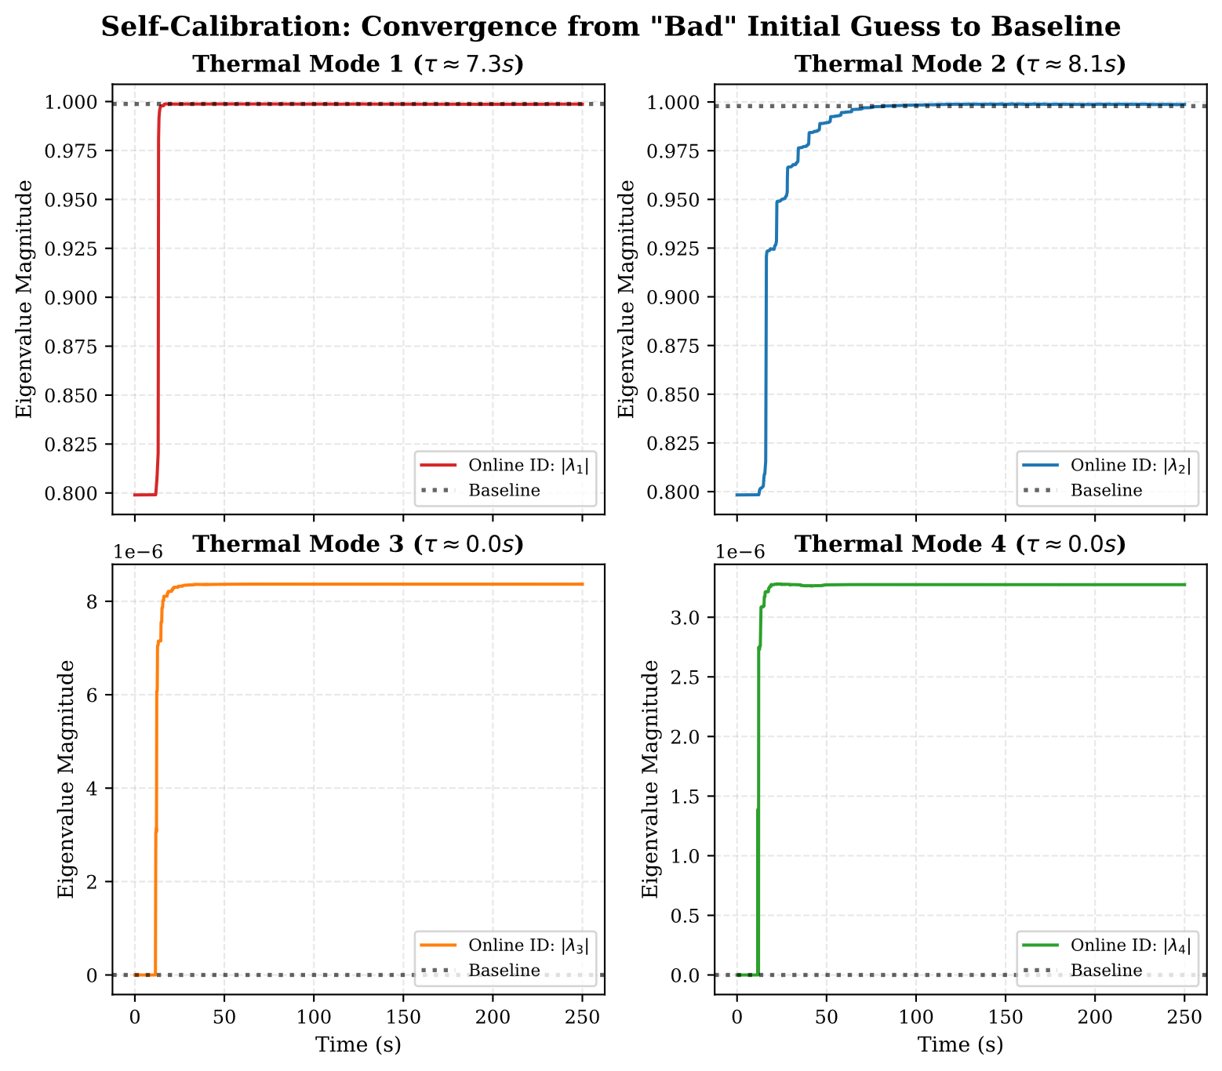
DMD Results
Adapted model
Adapted model
Initial guess
Initial model
Fig. 19 Online DMD convergence
Fig. 20 DMD DT Validation
Introduction
Review
Methodology
Results

Slide 18
Summary
Method | Primary Strength | Main Challenge | Best Use Case
Online PSO (with 40% Reset) | Global Search: Excellent at finding parameters in non-convex spaces without needing a gradient/Jacobian. | Stochastic: Computationally heavier per iteration; requires windowed data for convergence. | Initial Calibration: Best for finding the baseline "Golden Model" Cauer parameters offline or during startup.
Augmented EKF (Log-Space) | Recursive Efficiency: Updates at every sample; provides a covariance matrix (uncertainty) for health monitoring. | Local Convergence: Requires accurate initial guesses; sensitive to process noise tuning. | Continuous Tracking: Ideal for real-time monitoring of parameter drift (aging) during operation.
Hankel-DMD (Reduced Order) | Temporal Memory: Captures complex diffusion dynamics (4-mode) without needing a manual RC structure. | Data Driven: Lacks direct physical layer interpretability. | High-Speed Control: Best for fast Tj prediction in complex multi-chip modules with cross-heating.
Conclusion: The ideal method depends on the module complexity, and desired application, but it should be sensitive to both fast and slow thermal constants.

Slide 19
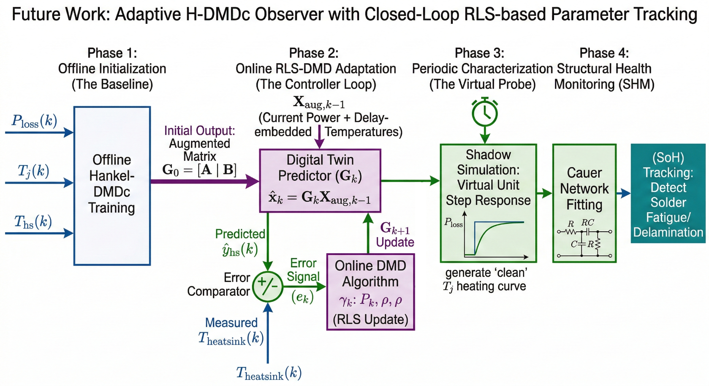
Future Work
Extend the Digital Twin to include heatsink temperature-based adaptation.
Enhance the physical interpretability of DMD-derived thermal parameters.
Fig. 20 Future work scheme [*]

Slide 20
References
[1] IEA, “Global stock of public charging points by speed, 2018-2024 – Charts – Data & Statistics.” Accessed: Dec. 26, 2025. [Online]. Available: https://www.iea.org/data-and-statistics/charts/global-stock-of-public-charging-points-by-speed-2018-2024
[2] J. Kuprat, K. Debbadi, J. Schaumburg, M. Liserre, and M. Langwasser, “Thermal Digital Twin of Power Electronics Modules for Online Thermal Parameter Identification,” IEEE J. Emerg. Sel. Topics Power Electron., vol. 12, no. 1, pp. 1020–1029, Feb. 2024. doi: 10.1109/JESTPE.2023.3328219.
[3] COMSOL, “Thermal Analysis of a Bipolar Transistor.” Accessed: Dec. 29, 2025. [Online]. Available: https://www.comsol.com/model/thermal-analysis-of-a-bipolar-transistor-19701
[4] Y. Tang et al., “Physics-Informed Intelligent Thermal Model for SiC Power Modules With High Generalization,” IEEE Trans. Power Electron., vol. 40, no. 10, pp. 14459–14477, Oct. 2025. doi: 10.1109/TPEL.2025.3577241.
[5] J. L. Proctor, S. L. Brunton, and J. N. Kutz, “Dynamic mode decomposition with control,” Sep. 2014, arXiv: 1409.6358. doi: 10.48550/arXiv.1409.6358.
[6] H. Zhang, C. W. Rowley, E. A. Deem, and L. N. Cattafesta, “Online dynamic mode decomposition for time-varying systems,” Jul. 2017, arXiv: 1707.02876. doi: 10.48550/arXiv.1707.02876.
[7] M. Votava, K. Debbadi, Y. Pascal, and M. Liserre, “Multi-step Least Squares Algorithm for Thermal Characterization Based on Mission Profile,” in 2024 IEEE Applied Power Electronics Conference and Exposition (APEC), Feb. 2024, pp. 1566–1573. doi: 10.1109/APEC48139.2024.10509492.

Slide 21
Acknowledgement
[†] Experimental Validation: All raw thermal experimental data for the modules was graciously provided by Dr. Martin Votava
[*] Technical Visualizations Note (diagrams):
Some of the diagrams and system architecture illustrations presented in this seminar were designed by the author and rendered using Generative AI (Gemini 3 Flash/Nano Banana 2). All visual logic, mathematical notations, and block structures are derived directly from the underlying CauerEKF and DMDc Python implementation to ensure technical fidelity.

